Slide 1
Introduction to Neo4j - a hands-on crash course
Chintan Desai
Neo4j Ninja
Senior Specialist Software Engineer, NICE Ltd.
Ex Neo4j Consulting Engineer
LinkedIn: chintandesai7
Medium: @chintan-desai
Notes:
Thank you Sid for arranging this and inviting me for the Neo4j introduction session for APAC.
Hello everyone. Good morning, good afternoon, good evening based on what time zone you are in.
My name is Chintan Desai. I am based in Pune, India. I am a Software Engineer.
Currently working with Nice Systems Limited. Here because of my love for Graphs, and Neo4j Graph Databases.
I spent a good amount of time as a Consulting Engineer at Neo4j and now trying to contribute my part to the community.
Today we will go through introduction of Neo4j. We will cover the basics of graph and graph-based problems.
Then we will discuss about Graph database and have an introduction of Neo4j Property Graph Database.
Then we will do some hands on so you can get started with Neo4j.
In the end we will talk about how you can move ahead in your Graph Database journey.

Slide 2
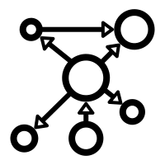




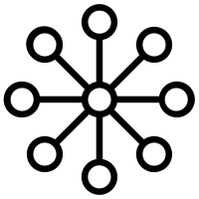

What are we covering
What are Graphs and why they are amazing! Spotting Graph-shaped problems
Neo4j - the Property Graph Model, and an Introduction to Cypher
Hands-on: the “Movie” graph on Neo4j AuraDB Free
Demos: Neo4j Data Importer & Bloom
The Neo4j Graph Data Platform
Continuing your Graph journey with Neo4j
Notes:
So, as I said, below are the areas we will explore.
we will talk about Graphs in general. Why graphs are amazing?
Why are they a really great representation of the real world? Where can we use graphs? What are scenarios or use cases for using graphs?
Looking a little bit at the property graph model and a quick introduction to Cypher, our query Language.
And then what we actually want to do is we want to go hands-on. And all of you can code along with us here because we can use Neo4j AuraDB Free, which I think was already shared in the registration notes that you should have set up an account there. So, it should be pretty straightforward and quick to create a database there.
If not, or if you have missed, I will cover the steps in the presentation.
Then we will explore the Movies graph with Neo4j Brower to execute Cypher queries and visualize the results, Neo4j Importer to have a glimpse of easy way to import data to Neo4j and lastly Neo4j Bloom for Visualization.

Slide 3
…because it takes a few minutes to launch
Let's get started with
AuraDB Free
neo4j.com/aura
Do ask in the chat if something doesn't work!
Notes:
Before we start with the actual content, let's go over to the Neo4j Aura Website.
Neo4j Aura is a Database as a Service that can availed to run Neo4j Graph Database with a matter of few clicks and you can set and run your database without any hassle of database installation and administration.
Log in to Neo4j Aura Console and create our database so that we can together then have the database ready when we start. It takes a few minutes to start the database. So from that perspective, we can start it now. And then when we come back, it'll be there and up and running.

Slide 4

Time to have a go! with AuraDB Free!
Go to dev.neo4j.com/aura-login OR console.neo4j.io
Register and choose AuraDB
Click on Instances - New Instance
Choose the Movies Instance option
Click Create
Download/Save your generated password - keep it safe!
Wait for 3-5 minutes until your Database is ready for use!
Can’t access AuraDB Free? No problem! Use a Neo4j Sandbox instead
Go to dev.neo4j.com/try
Sign in & choose the Movies pre-built instance
Notes:
Here are the steps to setup a Neo4j Graph Database on Aura Console. I will go through the steps one by one.
If someone has any issue in accessing or setting up the Aura Instance, you can try the Neo4j Sandbox as an alternative.

Slide 5
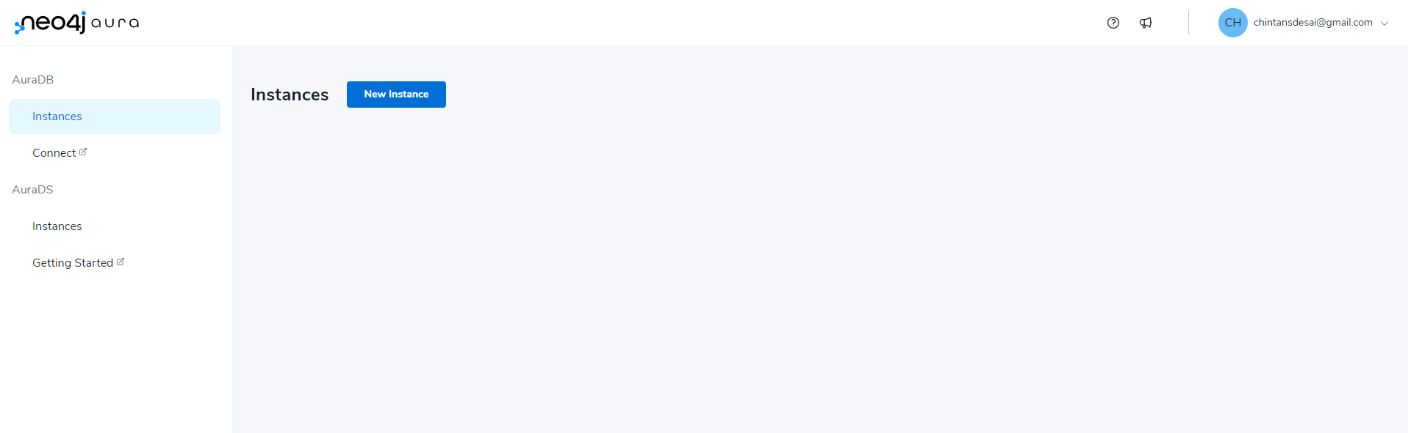
Notes:
So, when you go to the Aura Console and Login
Go to dev.neo4j.com/aura-login OR console.neo4j.io
Register and choose AuraDB
Click on Instances - New Instance

Slide 6
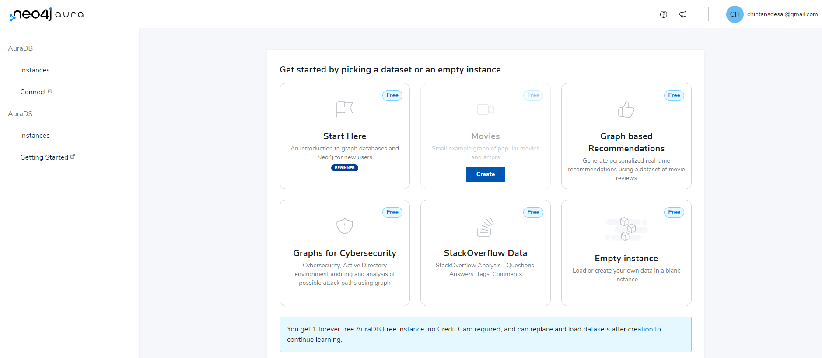
Notes:
It will show you some options to begin your instance with.
There are some pre-data loaded databases like Movies, Recommendations and many more. And there is an empty instance as well.
We will start with Movies database since we are going to do some hands on with Movies data.

Slide 7
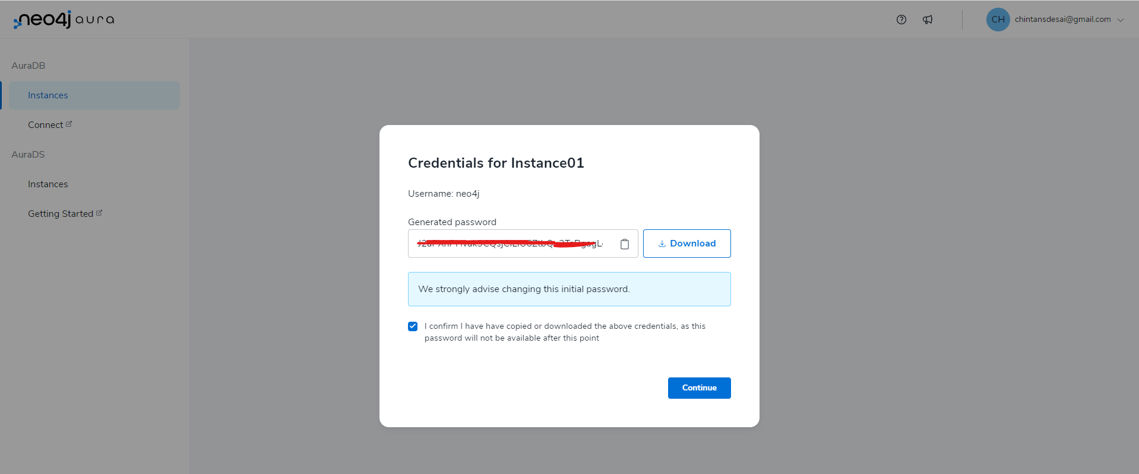
Notes:
This will show a popup where you can either copy your password or download the file. I recommend that you download the credentials file. It has details of your instance (Database Connection), username and password.
Once downloaded, click on continue, and let it spin up the instance.
This will take some time. Meanwhile we will run through some basics.

Slide 8
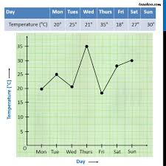
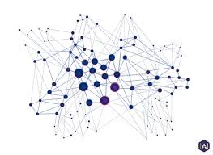

What is a Graph?
versus
Notes:
Okay, what's a graph? Is it the thing on the left or the thing on the right? So actually what we call a graph is the thing on the left.
It's a network of connected entities or connected nodes.
On the right side, oftentimes people call this a graph. We prefer to say like diagram or chart to make the distinction.
So for us, a graph and a network are what we are talking about versus diagrams and charts.

Slide 9

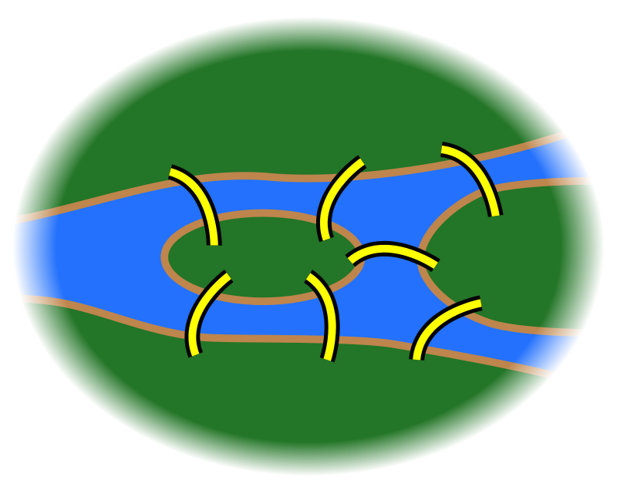
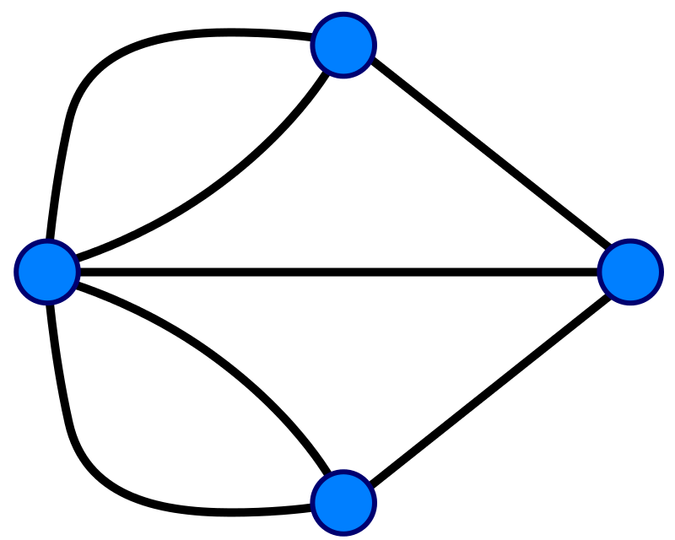
A Graph is …
… a set of discrete entities, each of which has some set of relationships with the other entities … the “mathematical” term for a network of vertices and edges is a “Graph”
The “Seven Bridges of Konigsberg” problem presented by Leonhard Euler in 1735 - The foundation of Graph Theory
Notes:
So, more on this. What is a graph? A graph is a collection of objects, each of which has a set of links with the other objects. Graphs are a useful way to model data for the purposes of mathematical analysis, and they have been around for quite a long time.
The first use of graphs was by Leonhard Euler in 1735; he used graph theory to prove that the famous Seven Bridges of Konigsberg problem had no solution.
If you’re curious, we can talk about the Seven Bridges problem and Euler’s proof, but this is all deep background for the main topics of interest.
************************************************ ***** Optional: What is the Seven Bridges problem? *****
Konigsberg, Prussia (now Kaliningrad, Russia) is a city spanning the Pregel River. It includes two large islands, which are connected to one another and to the river banks by seven bridges. A map of this arrangement is pictured on the left. The Seven Bridges problem is this: Is there any possible route through the city that crosses every bridge exactly once?
Some pen-and-paper experimentation will quickly suggest that there is no such route.
However, PROVING that there is no solution is much more difficult; Euler invented Graph Theory as a tool to aid this proof.
The graph representation of the problem is on the right: four landmasses, each represented by a node, and seven bridges, each represented by a relationship.
************************************************ ****** Extra Optional: What was Euler’s proof? ********
Euler observed the following:
The route taken within each landmass is irrelevant. Only the sequence of bridges crossed matters.
Whenever you enter a landmass via a bridge, you must leave it by a different bridge
...except at the start (where you leave but do not enter) and at the end (where you enter but do not leave)
Ergo, for the problem to be solvable, every landmass (except the start and end) must be touched by an even number of bridges
Based on the above observations, the problem has no solution, because all four of the landmasses are touched by an odd number of bridges.

Slide 10
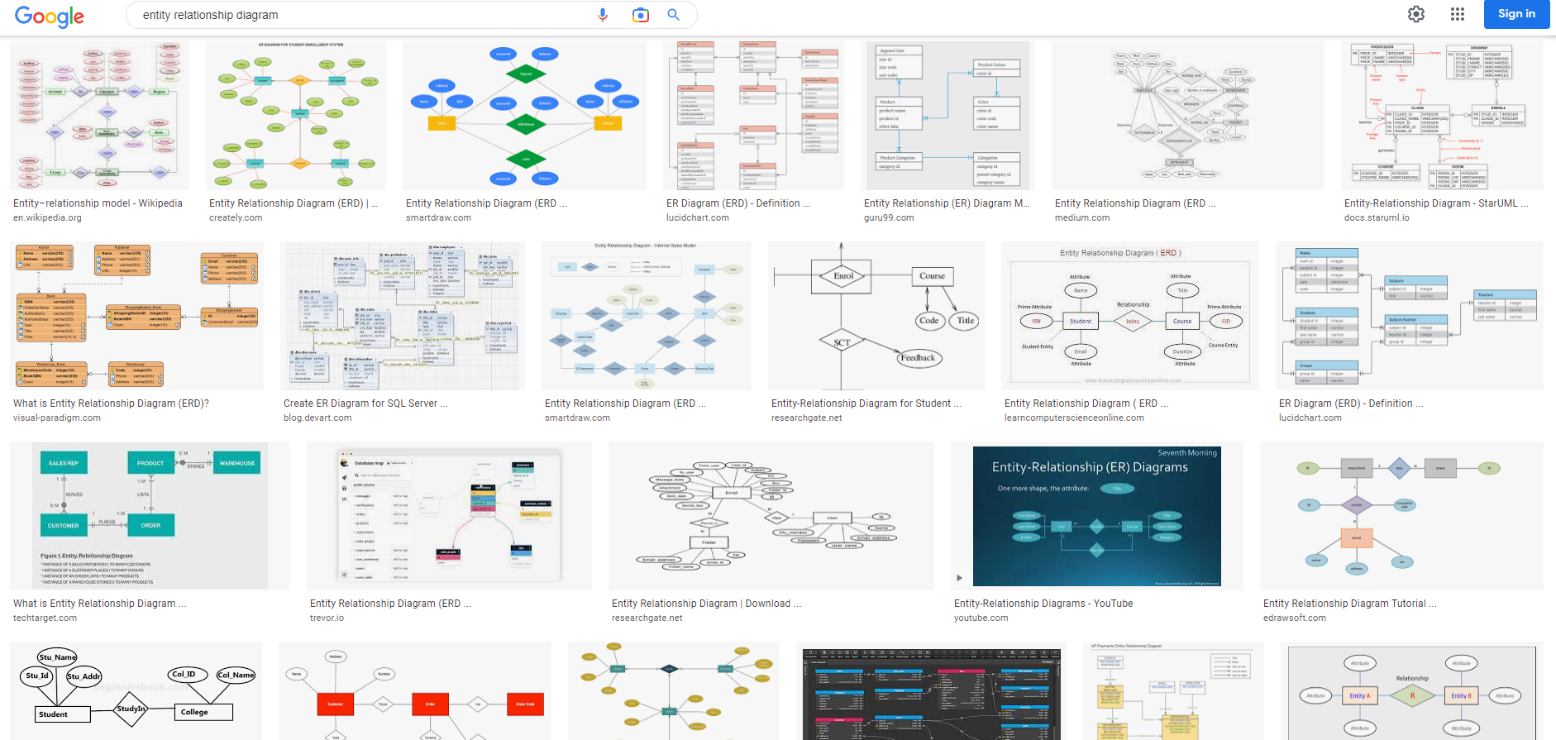
Graphs are everywhere !
Notes:
Graphs are practically everywhere.
If you search images on google with problem and many of the times you will see a graph-based representation image coming up as a solution.
Many times, when we have a problem, we tend to draw the connectivity and data flow for the problem to arrive at a solution.

Slide 11
Why are Graphs amazing? Some real-world examples of Impact …
Notes:
Okay, So actually everything that you can connect is a graph.
So, I always say there's no such thing as disconnected pieces of information in the world, right?
So, there's people who have connections, historical events which kind of have reasons why they happen, but they also have outcomes.
There is things like proteins in biology, for instance, right?
There are things like markets, economic markets. Especially today, we see that a lot, like there's so many dependencies on markets.
If just directly, but also transitively. So not just the organization that's cut off from the market, but also all their dependents, right? So things like network dependencies in software. For instance, what about my libraries and the libraries' libsomeone cuts someone else off a market, then they have a lot of problems, right?
And what about security there, right? So, what happens if one of these libraries that I'm not directly depending on but I'm depending on like three steps removed has a security issue? I'm still affected by that because I transitively use this library.
So, there's lots of things. So here, for instance, water is a very simple molecule, H2 & O.
And so, transport networks, there's like information networks, there's even like data centers and all the cabling routers, switches and so on.
So basically, the means are endless.
So, imagine if we can save the flow or connectivity in the same way as we think or draw on paper?
That is what a Graph Database is. It saves the data in a same manner as per representation.
Nodes & Edges.

Slide 12

The Panama Papers, 2016
Notes:
If we look into some exciting real-world examples, there are many.
Like the Panama Papers, came out in 2013, exposing many HNI’s involvement in some fishy practices.

Slide 13
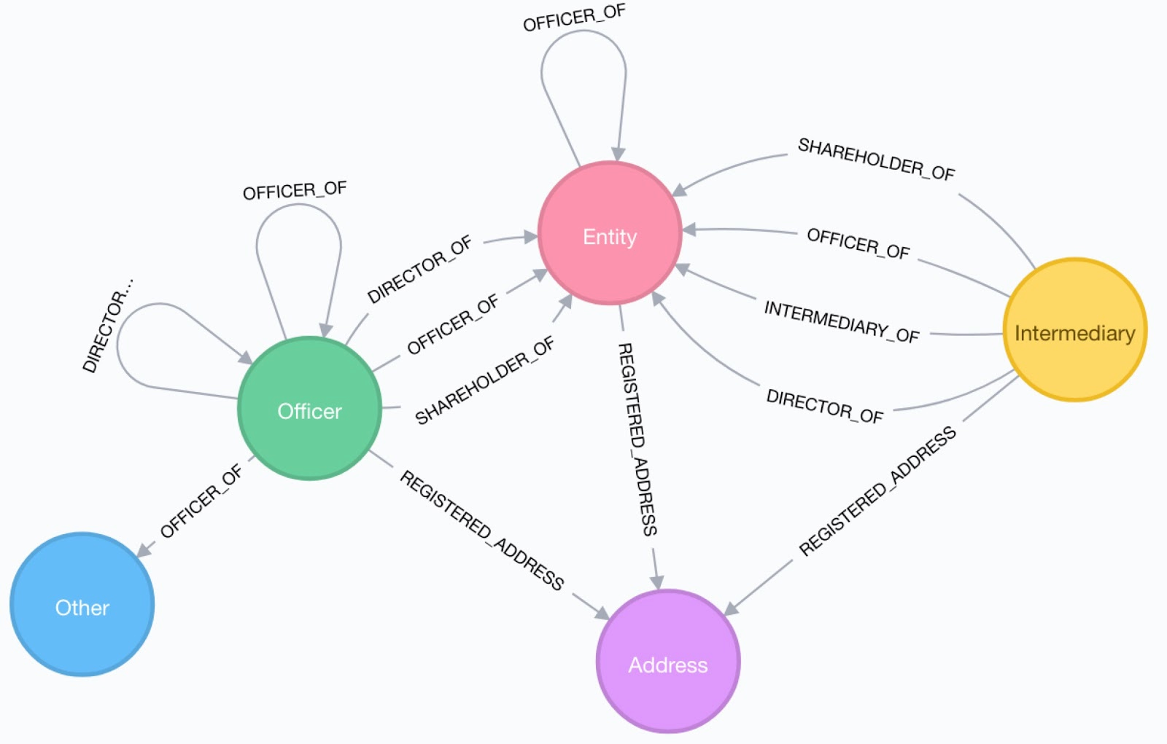
The “Panama Papers” Graph Data Model
Notes:
The research was done using the Graph Database. You can see the Graph data model that was used in research and investigation.

Slide 14
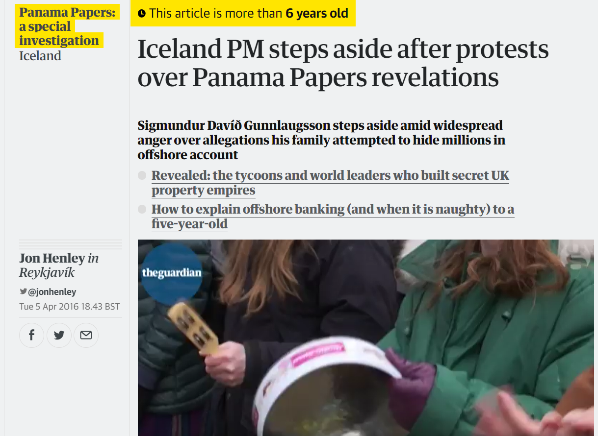
The Panama Papers, 2016
Notes:
And it revealed some serious and not previously known information, news created a lot of movements.

Slide 15

The Paradise Papers, 2017
Notes:
Same was Paradise papers. Research backed by a Graph database.

Slide 16

The Pandora Papers, 2021
Notes:
Pandora papers in 2021.

Slide 17
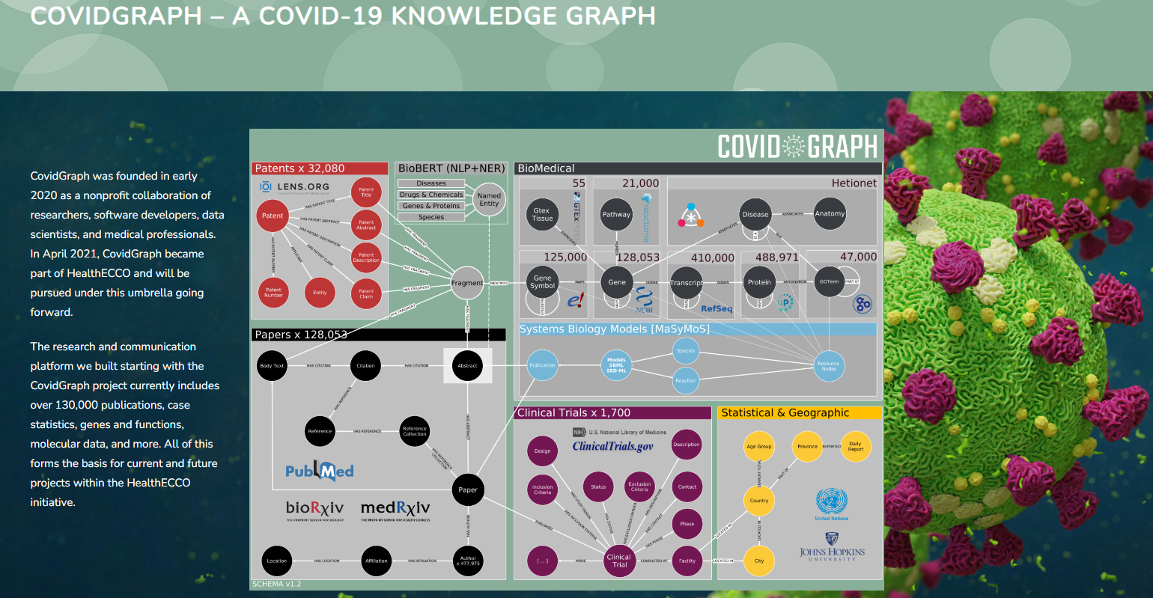
The Covid Graph Project, 2020
Notes:
When Covid hit, There were many projects for tracing the contacts of covid patients, having some research on the COv2 virus sequences etc, were performed using Graph Database.

Slide 18
What makes for a good Graph problem to solve for?
Notes:
Okay, so moving on to- What makes for a Good Graph problem to solve for?

Slide 19
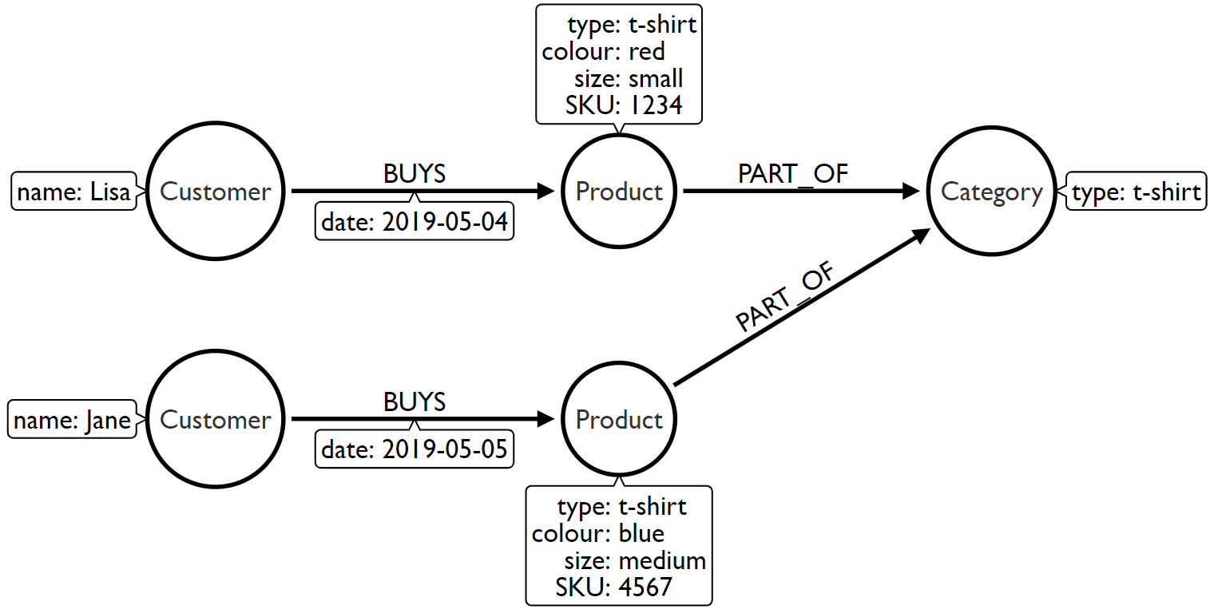





Scenario 1: Does our problem involve understanding relationships between entities?
Use Cases:
Recommendations
Fraud Detection
Entity Resolution
Data Lineage
Social Networks
Notes:
There a bunch of good graph use cases and scenarios.
So whenever these relationships, context, or this topology of my entities is as important as the entities themselves, and I want to use that to analyze my data or to work with my data, or to infer more insights from my data, than considering a graph database makes a lot of sense.
Right, so if those relationships are more than just a foreign key that I don't really care about as such, but it's really the relationships between entities are important in my domain.
And I think personally in most domains, actually, the connections of entities are way more important than entities interestingly, right?
And here are some examples.
Most obvious, a social netowork – like LinkedIn. Where you are connected to some connections, they are connected to some more amd so on.
Something else that's interesting is all kinds of hierarchies, you have hierarchies in product hierarchies, you have sales and purchase hierarchies, you have buildings, if you want to represent a building or a complex piece of machinery like an airplane.
If you go like a BOM model, Bill of Materials model, then you have like the airplane, and then like all the parts and the parts consist of parts that it consist of parts and then so on. Or if you look at modern CPUs, for instance, right? So you have like substructures.
There are many more. And also if you go to neo4j.com/use-cases, there are many more listed in detail with example datasets, white papers and more detailed customers and so on.
Ofcourse I can represent this kind of connected information also with some other databases.
Like within relational database and join tables or with a document database and basically arrays of IDs that point to another document, for instance, right?
But the question is, this kind of relationship that's kind of treated like a stepchild in many other databases, in a graph database that's kind of first class citizen.
Ofcourse I can represent this kind of connected information also with some other databases.
Like within relational database and join tables or with a document database and basically arrays of IDs that point to another document, for instance, right?
But the question is, this kind of relationship that's kind of treated like a stepchild in many other databases, in a graph database that's kind of first class citizen.
There are many more. And also if you go to neo4j.com/use-cases, there are many more listed in detail with example datasets, white papers and more detailed customers and so on.

Slide 20
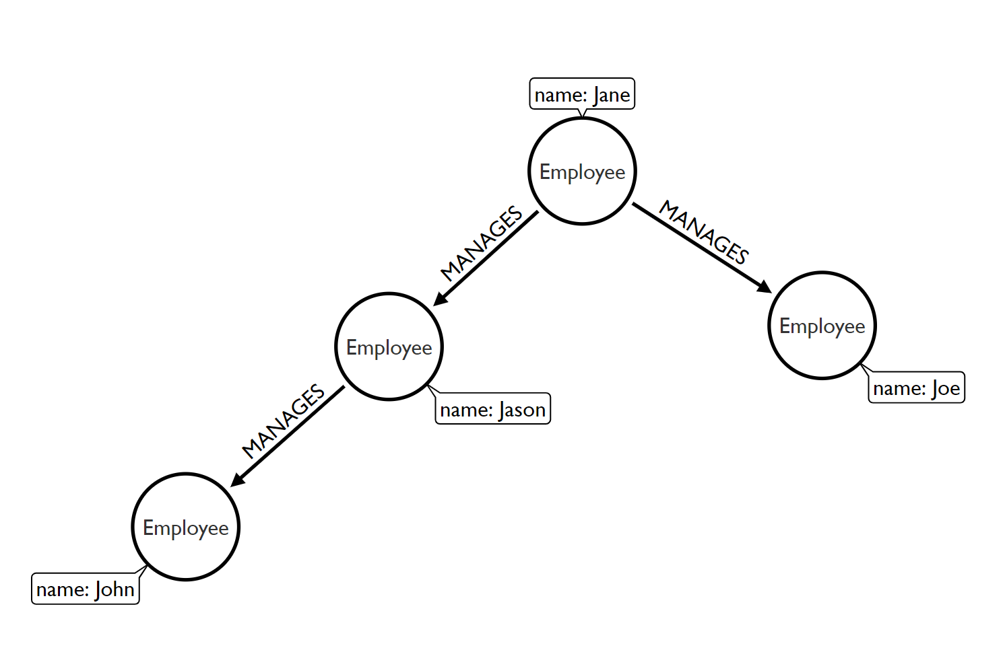
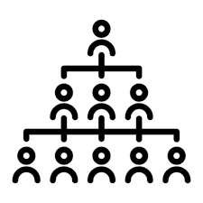

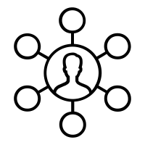

Scenario 2: Does the problem involve a lot of self-referencing to the same type of entity?
Use Cases:
Organisational
Hierarchies
Identity & Access Management
Social Influencers
Friends of friends

Slide 21
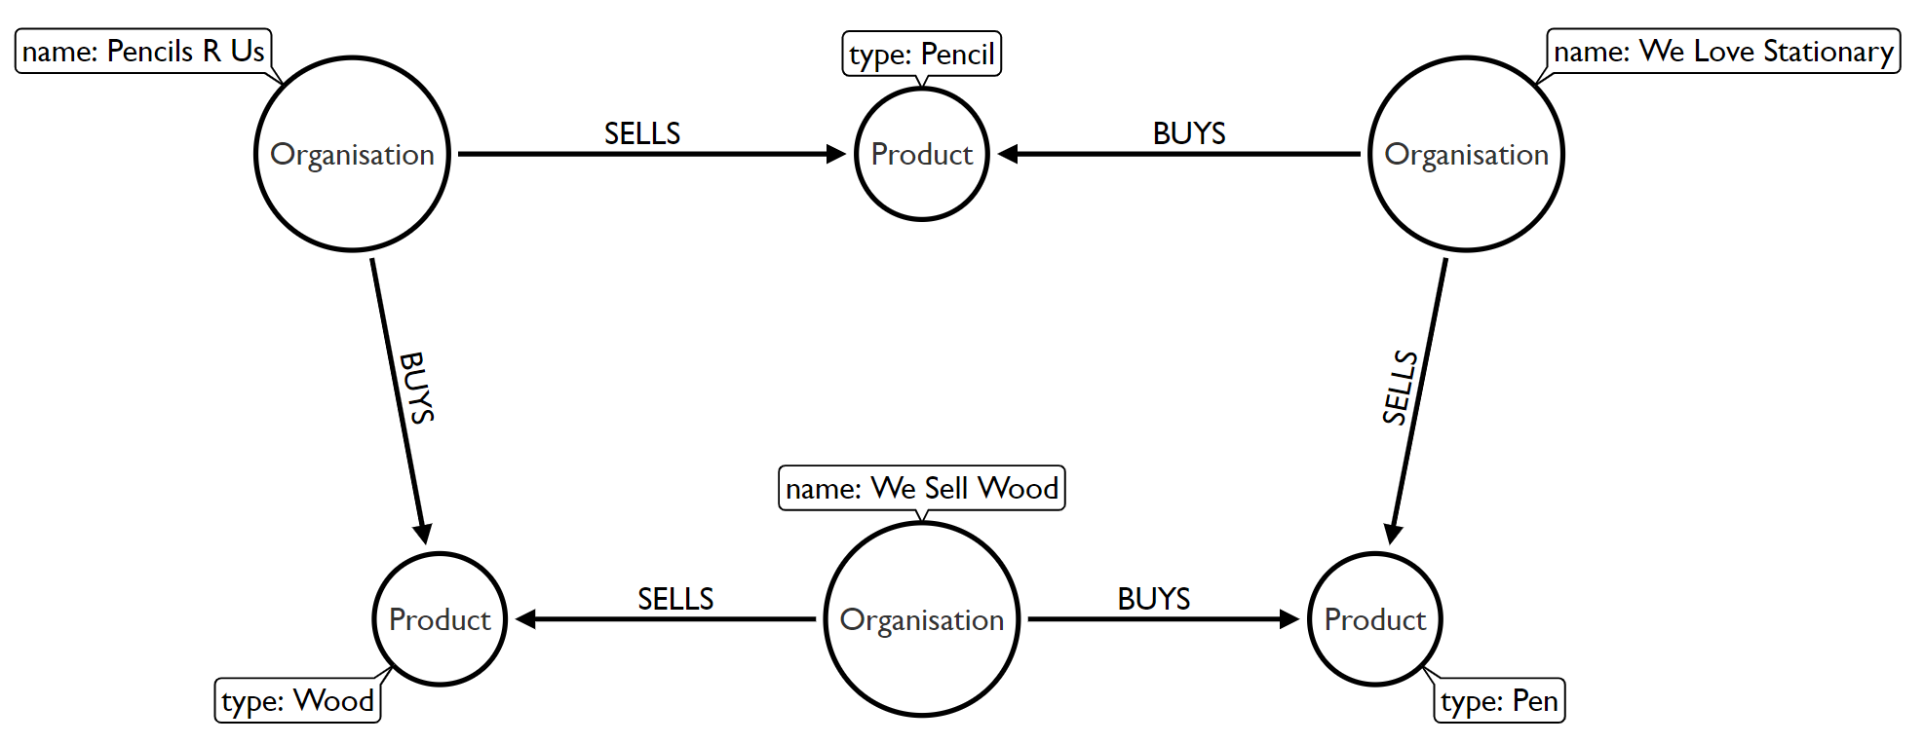
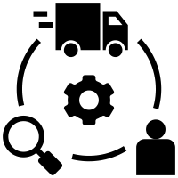

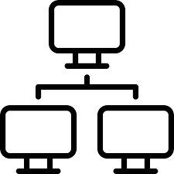

Scenario 3: Does the problem explore relationships of varying or unknown depth?
Use Cases:
Supply Chain
visibility
Bill of Materials
Network Management
Routing

Slide 22
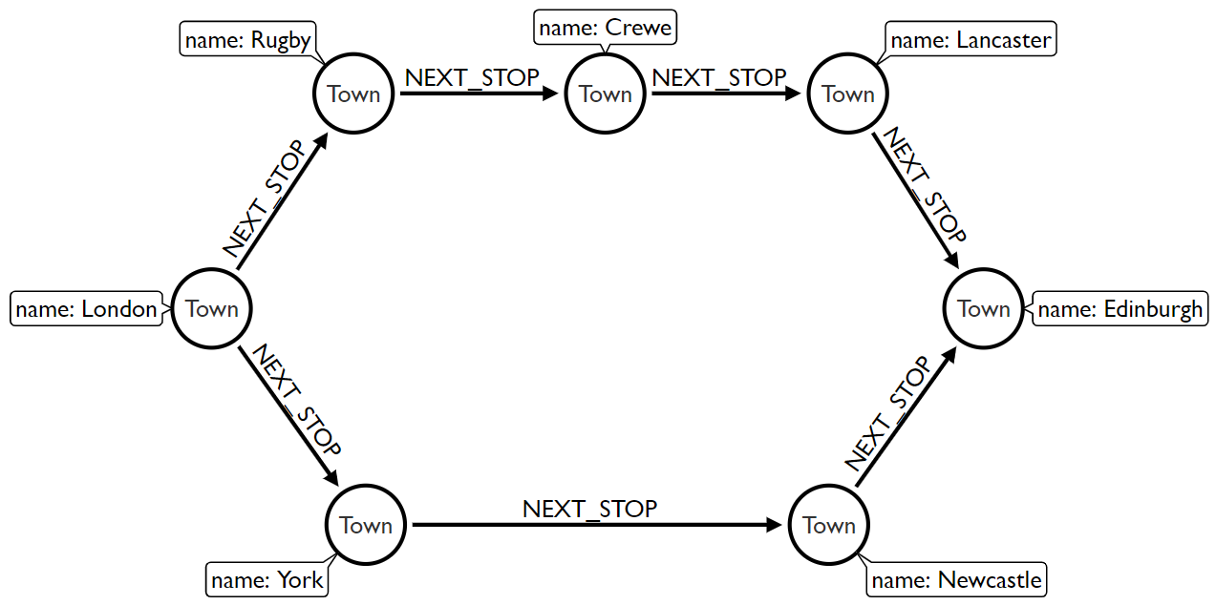
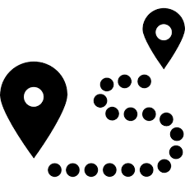

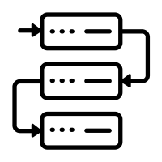
Scenario 4: Does our problem involve discovering lots of different routes or paths?
Use Cases:
Logistics and
Routing
Infrastructure Management
Dependency Tracing
Notes:
And again, routing, so this is basically a British road network or train network, basically.
They basically can say, can I do multi model transport like between a car, bike, public transport, and so on. And walking can I get from A to B? What's the shortest, what's the best?
What's the most scenic route? And helping me to find that.
So first presenting all of that as a complex knowledge graph, more or less, but then also having people find these routes and being more dynamic and having more information on the relationships that tell you, okay, is this like an easy route?
Is just kind of accessible for people with disabilities?
Is this something where I have a good view?
There's also stuff like cybersecurity, network management, identity and access management and so on. So like the possibilities are almost endless, which is also one of the challenges for a graph is you can do so many things. So it's really hard to pinpoint out only this is like the killer use case because there are so many things that you can do with it, right?
As I said, there are many more useful examples.

Slide 23
What is the Neo4j Property Graph Model ?
Notes:
Moving on to discuss more on Property Graph Model. So in a property graph model, there are properties on Graph obects.
In Neo4j, we can have Node and Relationships as primary objects. And we can have properties on these objects.

Slide 24

Nodes
Nodes ~ Vertices
Basic building blocks of a Graph
Used to represent Objects or Entities of interest in a given Domain
Can be labeled to form Groups of similar Entities
Can have one or more Labels
Can additionally have Properties
name: “Jane” age: 21 twitter: “@jane”
(:Person)

Slide 25

Relationships
Relationships ~ Edges
Used to connect Nodes
Provide structure to the Graph
Are first class citizens in a Graph
Must have a Type & Direction
Can additionally have Properties
Nodes can have multiple Relationships between them
A Node with no attached Relationships is permitted. A Relationship without Nodes is not.
since: 2011
OWNS
(:Person)
(:Vehicle) (:Car)
name: “Jane” age: 21 twitter: “@jane”
brand: “Volvo” model: “V70” year: 2010

Slide 26
Properties
Properties add color to the Graph
They enrich Nodes & Relationships with additional information
When used on a Relationship, they qualify a Relationship in terms of its strength or value
They are represented as key-value pairs
They may be unevenly distributed across Nodes or Relationships of a given Label or Type - if a value for a given Property does not exist, it simply isn’t created on a Node or Relationship !
since: 2011
OWNS
(:Person)
(:Vehicle) (:Car)
name: “Jane” age: 21 twitter: “@jane”
brand: “Volvo” model: “V70” year: 2010

Slide 27
The Property Graph Model
since: 2011
(Node) Labels
(Relationship) Types
Nodes
Relationships
Properties
OWNS
(:Person)
(:Vehicle) (:Car)
name: “Jane” age: 21 twitter: “@jane”
brand: “Volvo” model: “V70” year: 2010

Slide 28
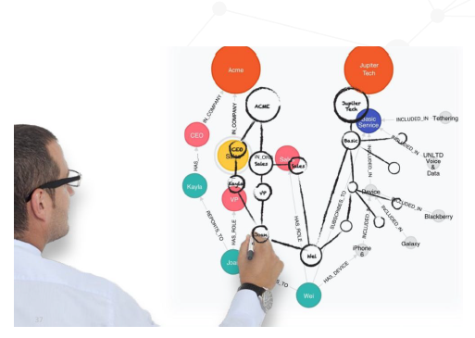
Cypher
A pattern-matching query language purpose-built for Graphs!
Declarative
Expressive - uses ASCII art
Built to be easily understood by both Developers and Business Users alike
Is contributing to GQL (an ISO standard for Graph query language) in a big way!
28￼
Notes:
Moving on, when you have Nodes, Relationships and properties in a Graph. How can you create, access and remove data in this database? This is where Graph Database Language comes to play.
Cypher is a language for Neo4j Graph Database.
Do not get overwhelmed thinking, hey, I need to learn a new language now ☺.
Cypher is a very easy query language.

Slide 29
Cheatsheet
Description | Node | Relationship
Generic | () | -- --> -[]-
With a reference | (n) | -[r]-
With a node label or relationship type | (:Person) | -[:ACTED_IN]-
With a label/type and an inline property | (:Person {name: 'Bob'}) | -[:ACTED_IN {role: 'Dave'}]-
With a variable, label/type and an inline property | (p:Person {name: 'Bob'}) | -[r:ACTED_IN {role: 'Rob'}]-

Slide 30
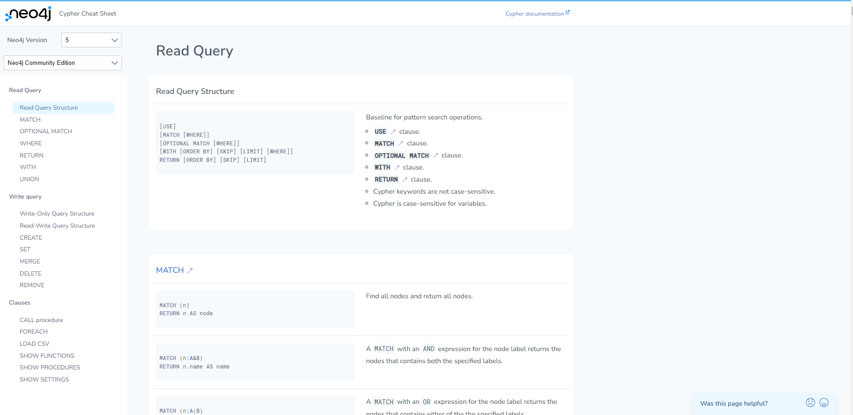
dev.neo4j.com/refcard
dev.neo4j.com/refcard
Notes:
If you want to have a quick reference guide for Cypher, just go to dev.neo4j.com/refcard, and this gives you the Cypher ref card, the current one, right? So if I go back here and say, dev.neo4j.com/refcard, then it takes me to the current Cypher ref card. And then I can look at all the things that I want to look up. So that's a quick reference for now.

Slide 31
… and now, let’s query the Graph together using Cypher !
Notes:
How do I get started with Graph Apps?
Your Neo4j Aura Instance must be up and running now. So lets move on to have some hands on.
We will start with Neo4j Browser tool. Browser is a simplified data access studio for Neo4j. Like SQL Server Management Studio for MS SQL.

Slide 32
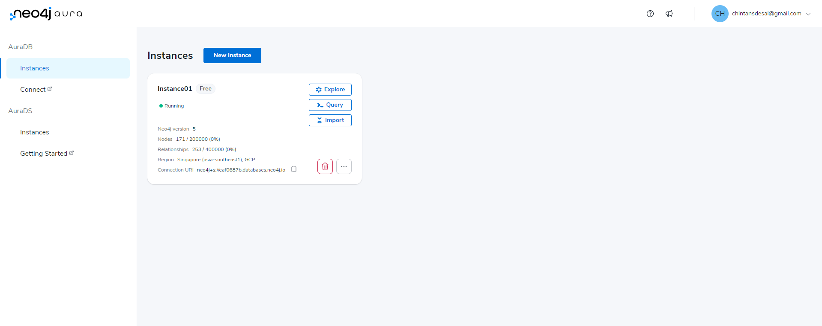

Slide 33
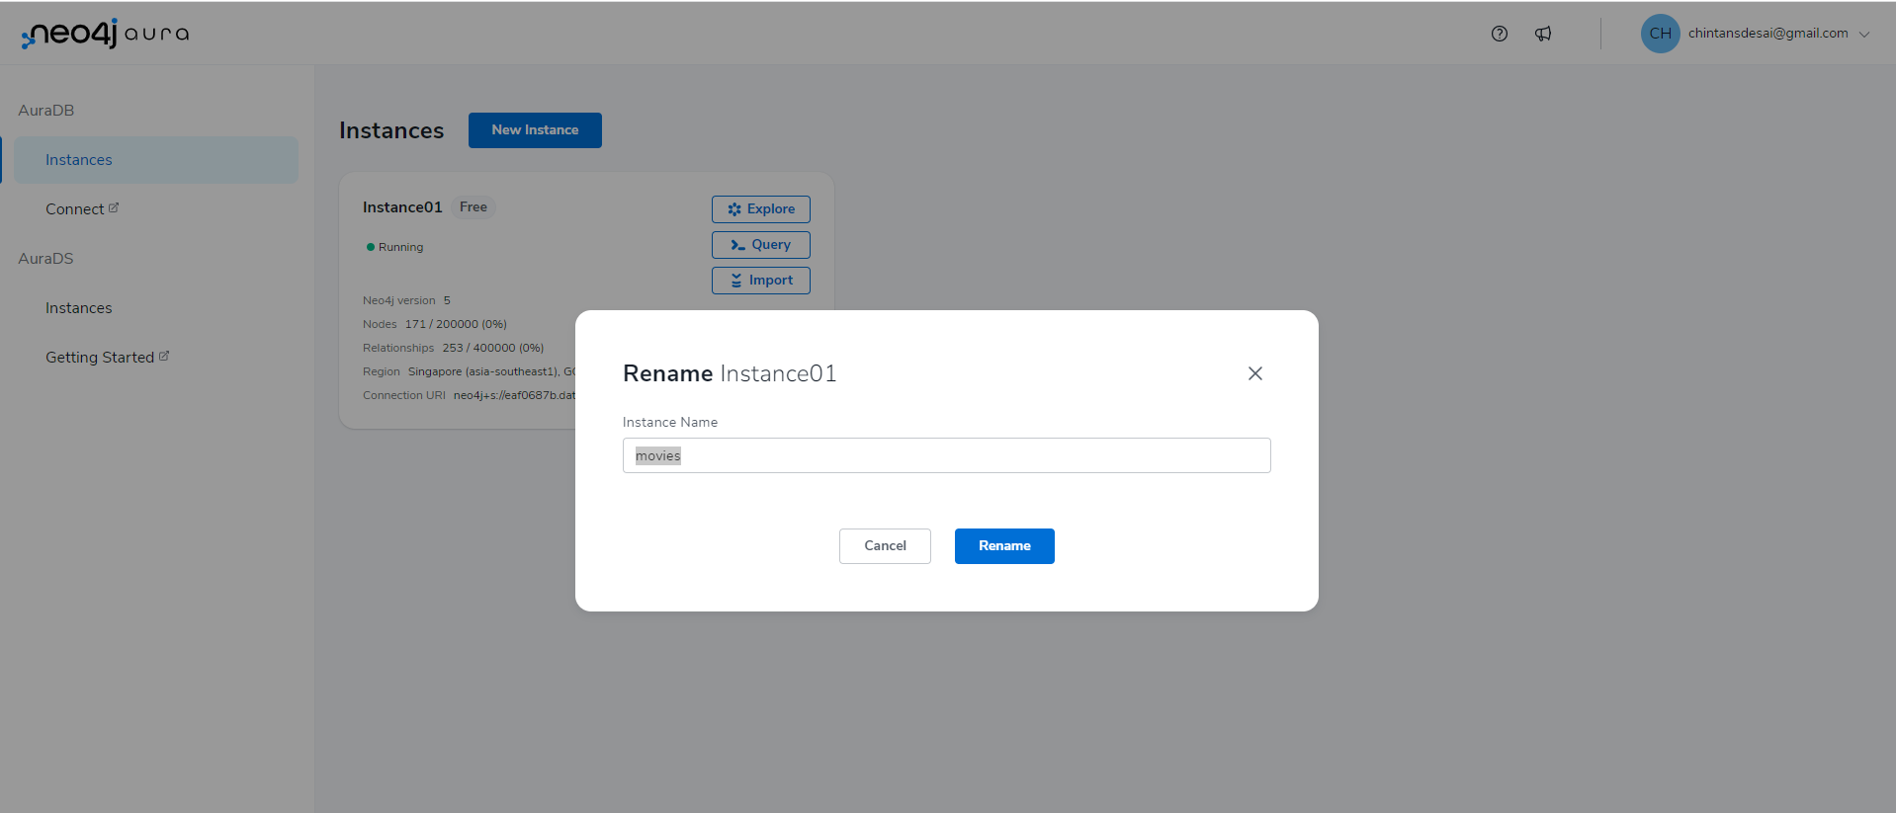

Slide 34
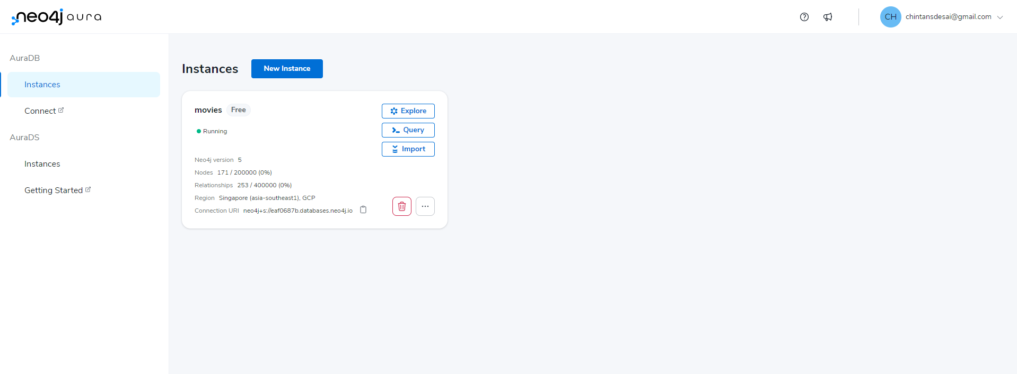

Slide 35
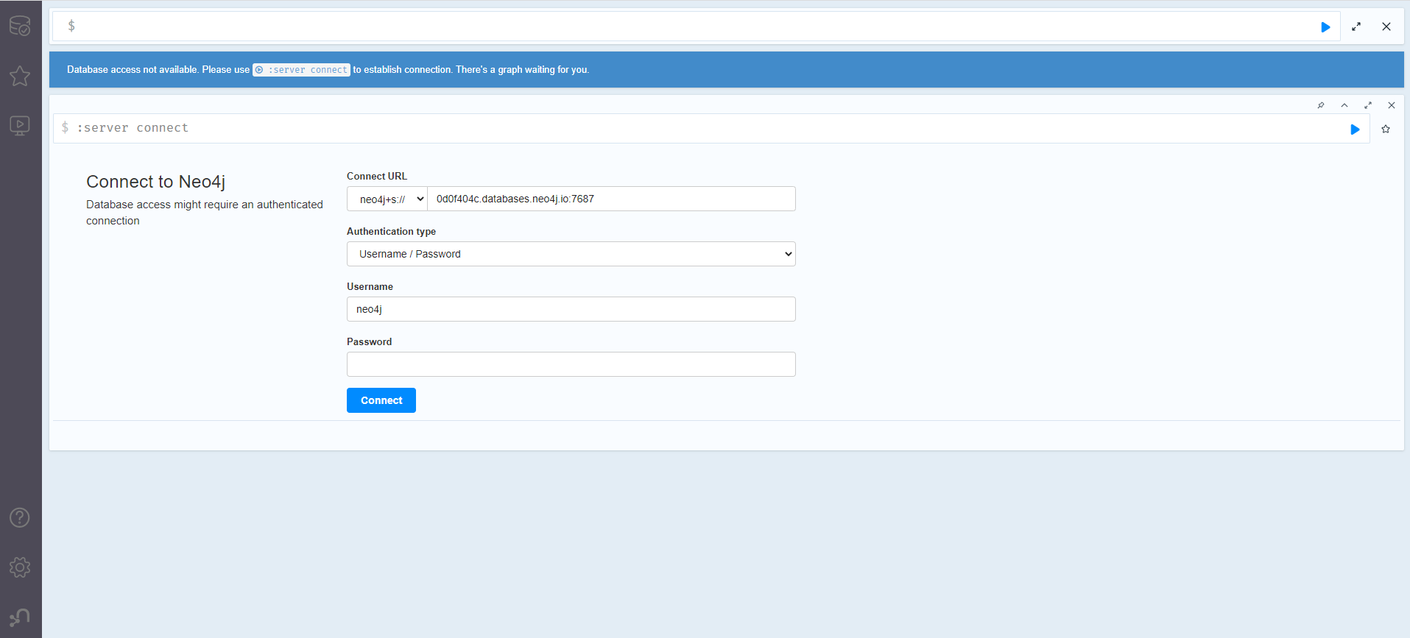

Slide 36
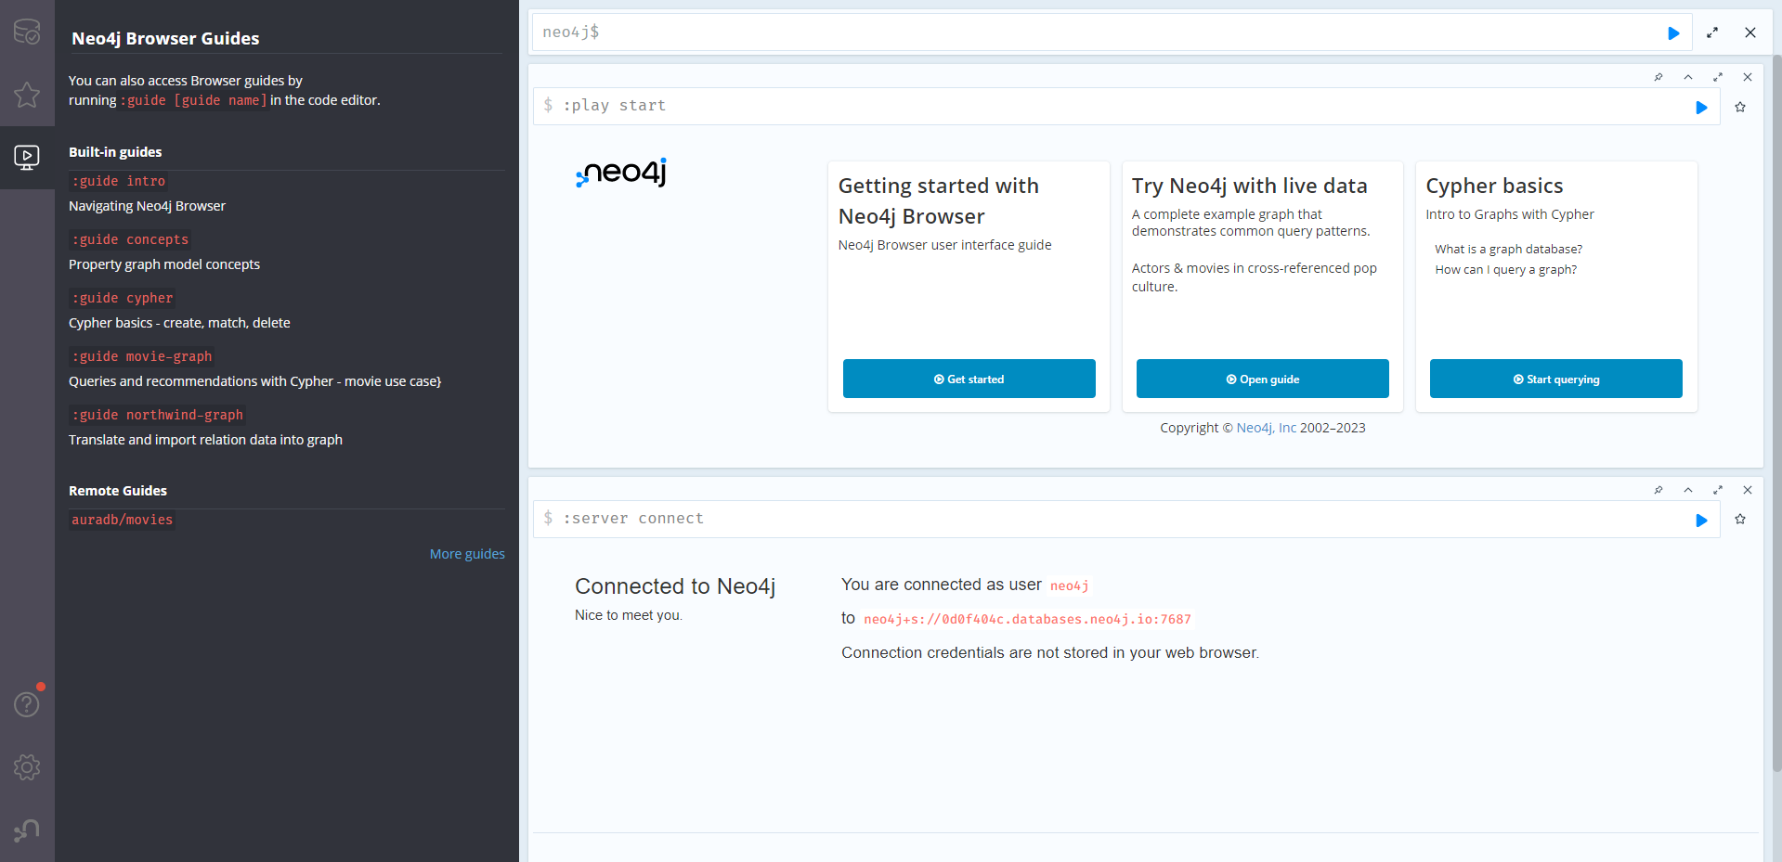

Slide 37
Follow along !
https://github.com/chintan196/neo4j-training/wiki/Workshop-Steps!

Slide 38
Neo4j Data Importer
dev.neo4j.com/moviedata
Notes:
Moving on the to next tool. The Neo4j Data Importer. It provides an easy interface to load data from flat files. I will run through and example.

Slide 39
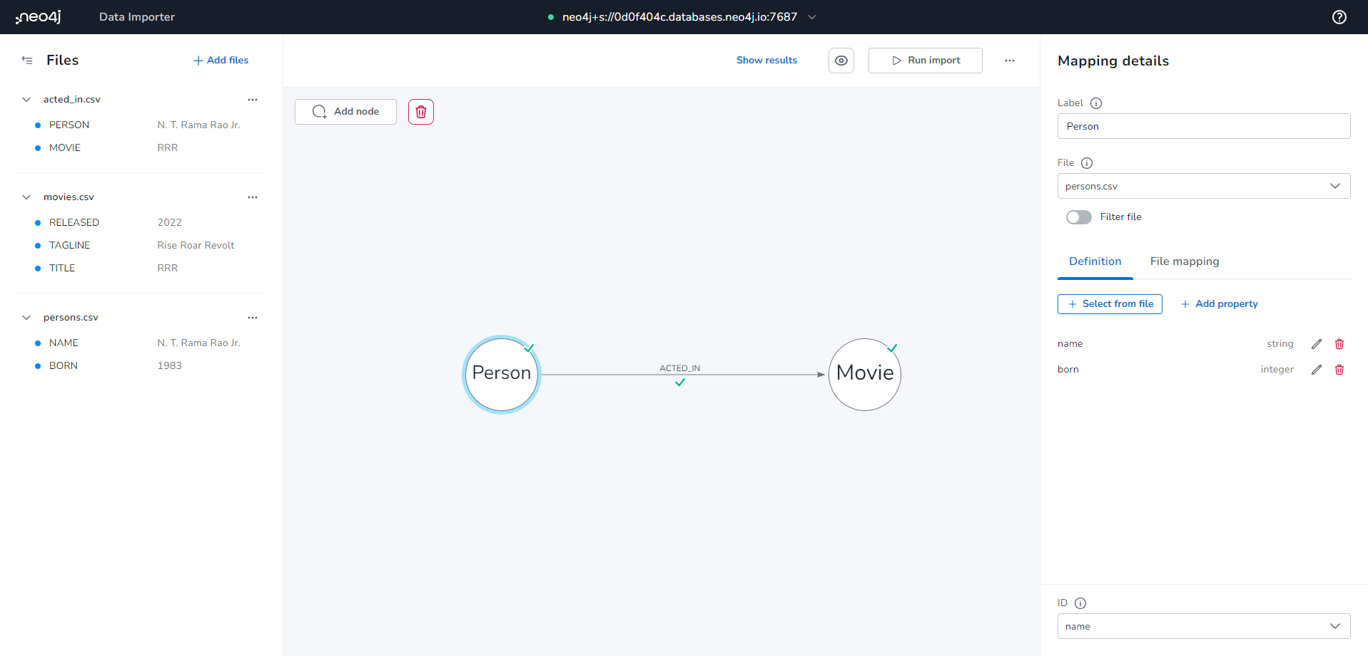

Slide 40
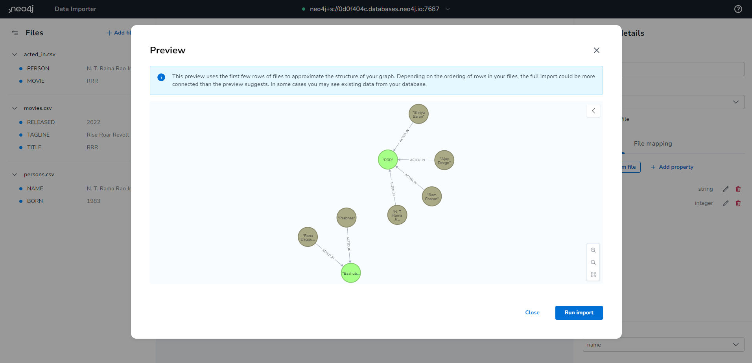

Slide 41
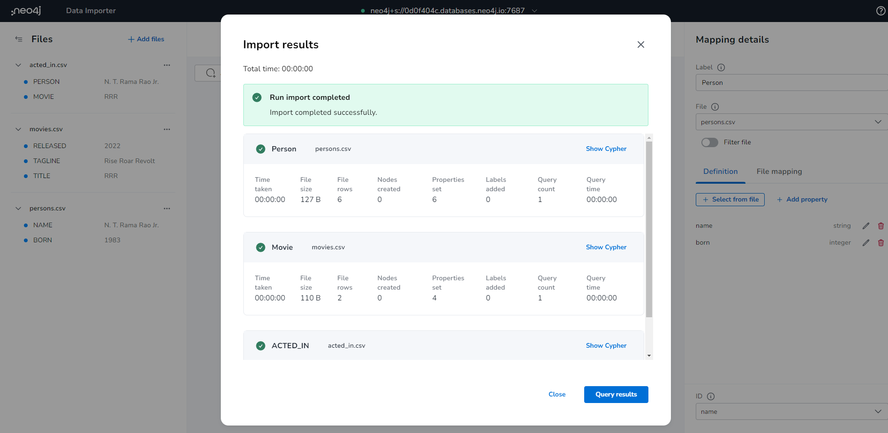

Slide 42
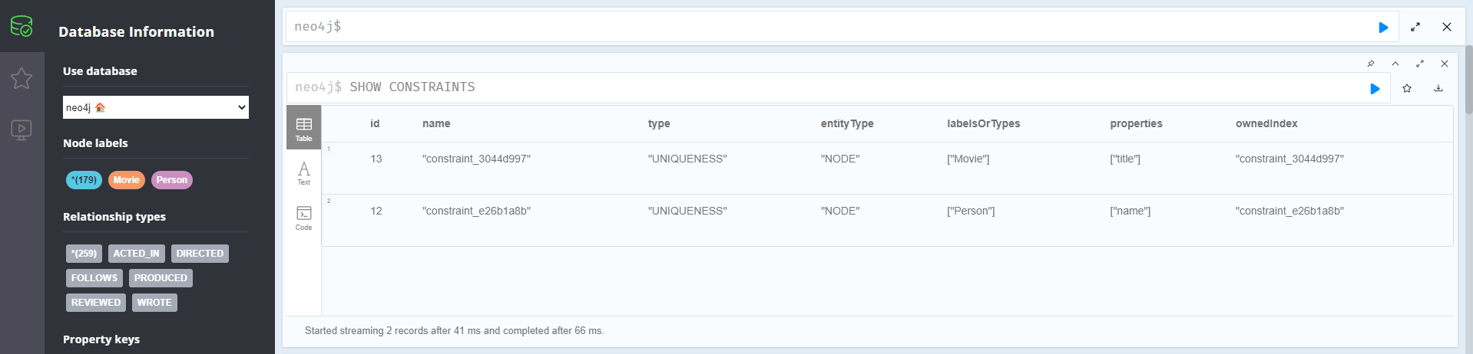

Slide 43
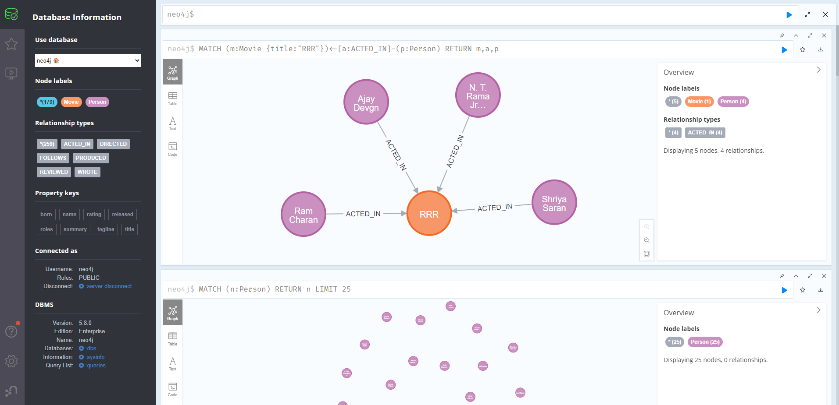

Slide 44
Neo4j Bloom
Notes:
Last tool to hands on today, is Neo4j bloom.
Bloom is a tool that provides Visual Representation capabilities over Neo4j Database. It can be handy for the audience like Data Scientists, Management Leaders, Business Analysts etc.

Slide 45
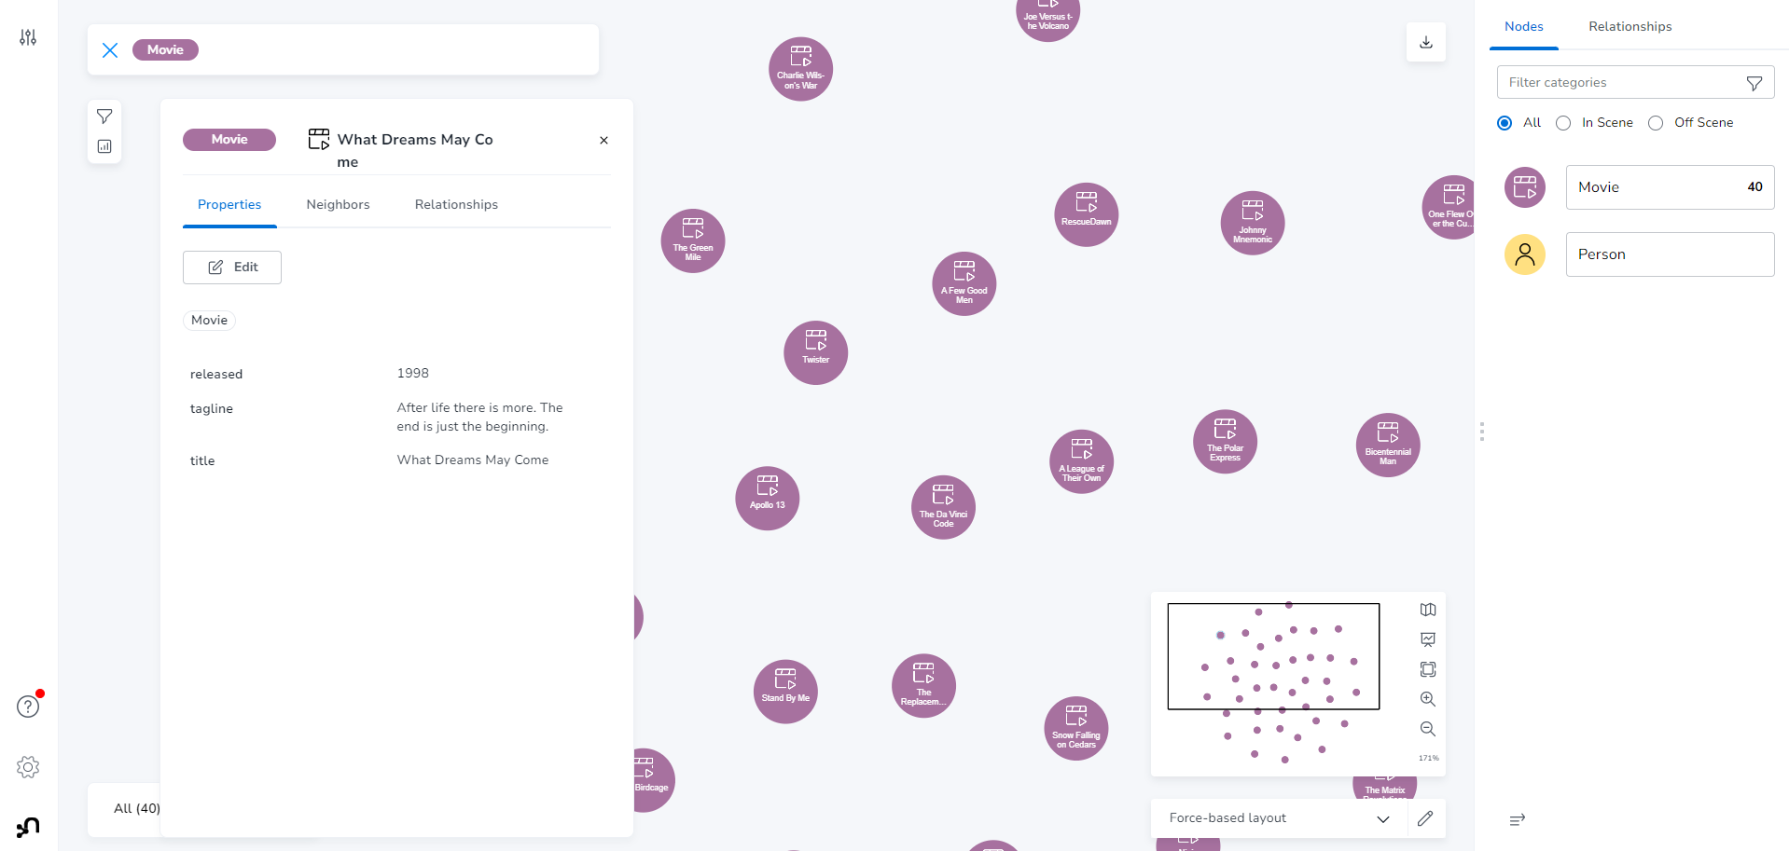

Slide 46
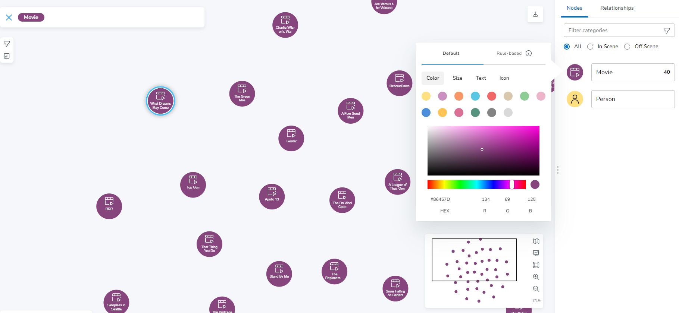

Slide 47
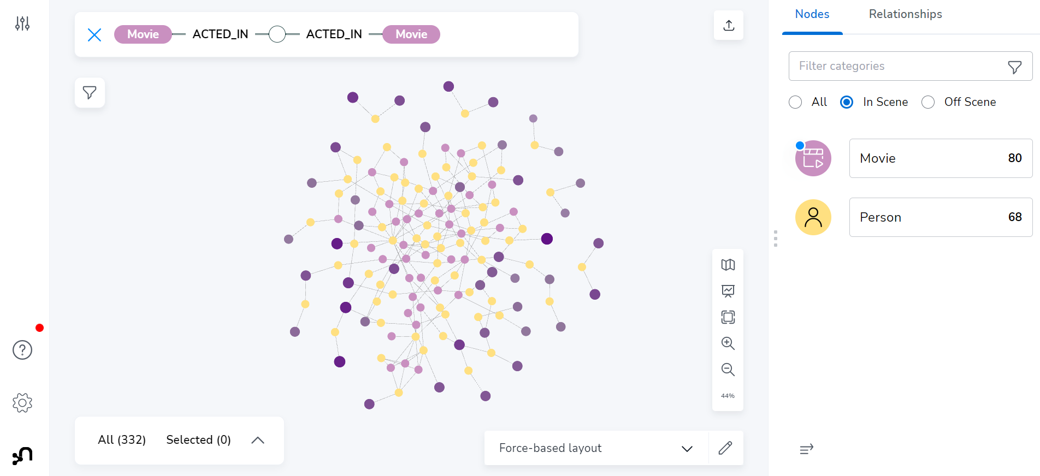

Slide 48
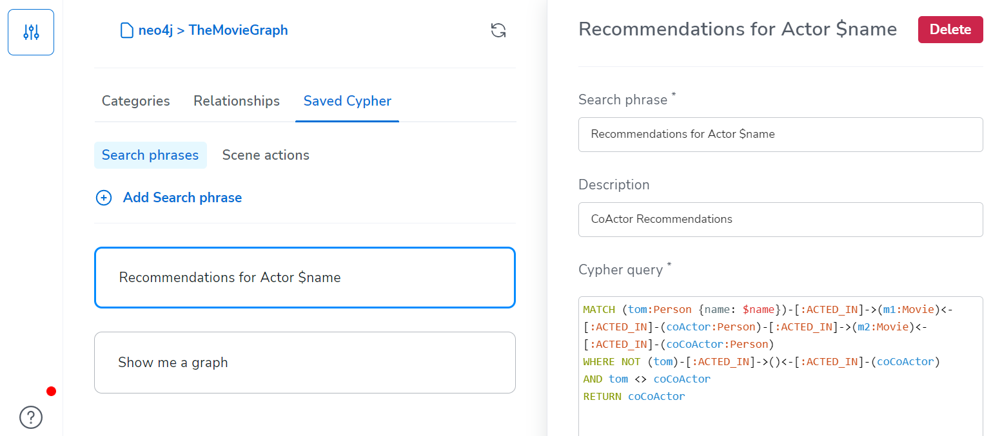
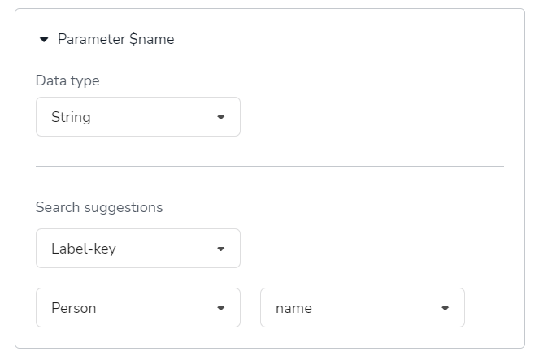

Slide 49
The Neo4j Graph Data Platform
Notes:
Okay. Let's talk more on Neo4j Platform.

Slide 50
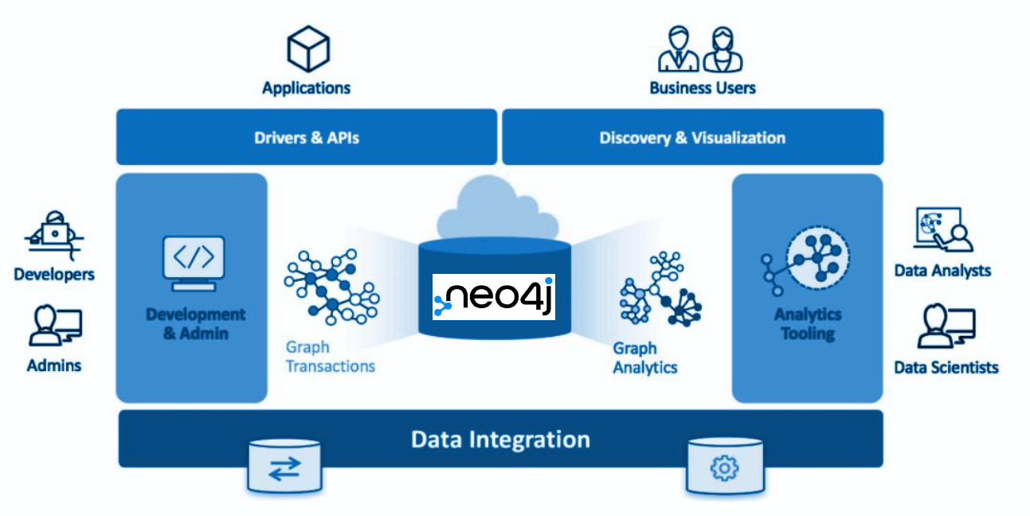
The Neo4j Graph Ecosystem

Slide 51

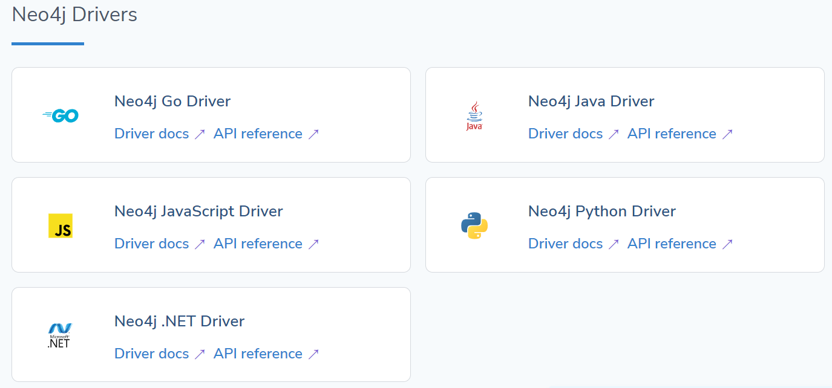
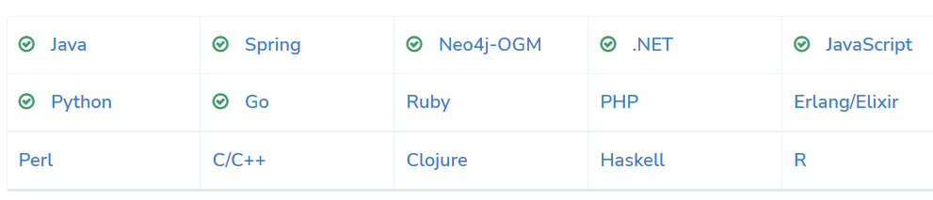
Language Drivers
Java
Javascript
.Net
Python
Go
https://neo4j.com/docs/drivers-apis/

Slide 52
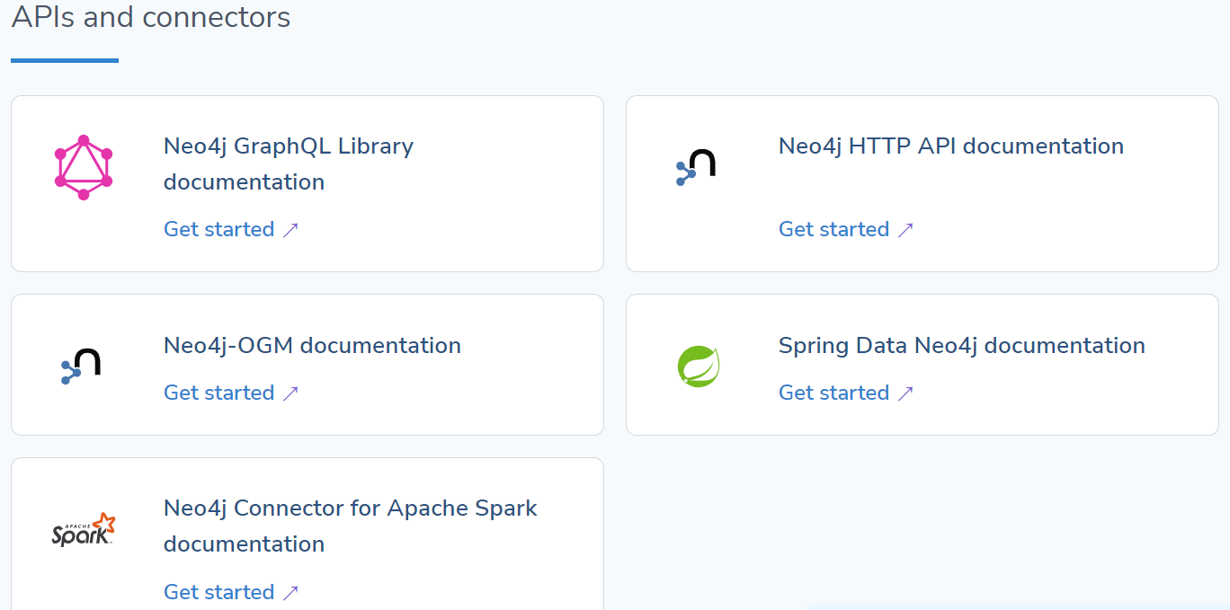
Connectors & APIs
Kafka Connect Connector
Spark Connector
JDBC Driver (RDBMS)
BI Connector (ODBC, JDBC)
Data Warehouse Connector
Spring Data Neo4j
Neo4j OGM
Neo4j GraphQL API
Neo4j HTTP API
https://neo4j.com/docs/drivers-apis/

Slide 53
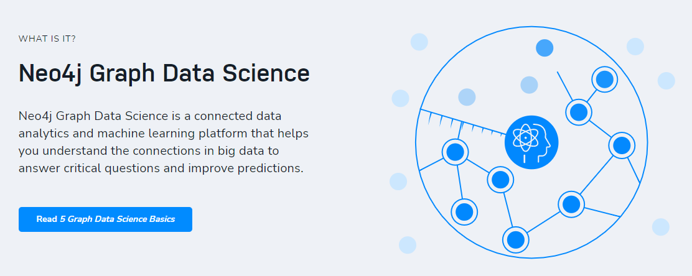
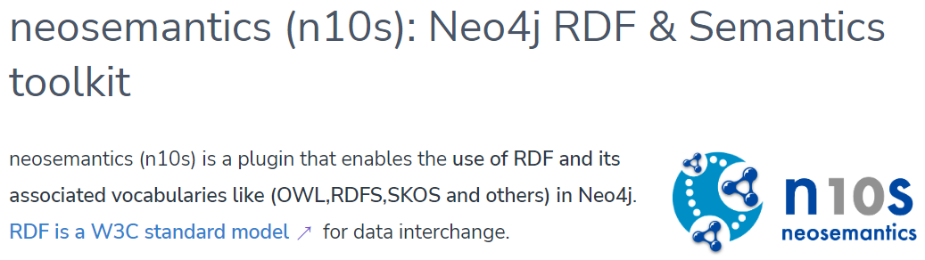
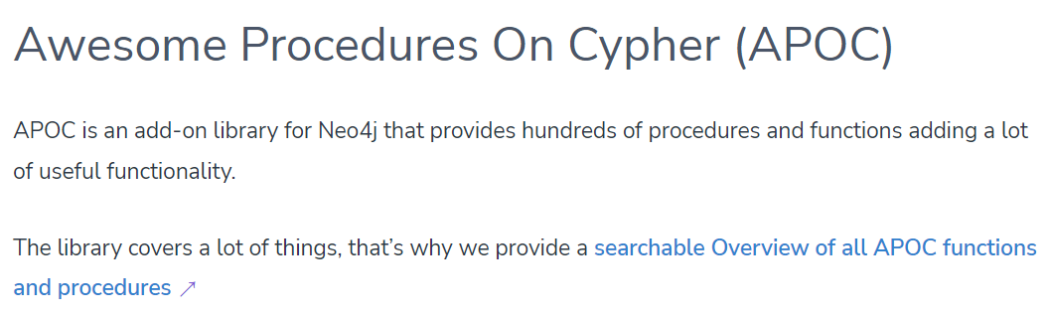
Libraries
APOC (Cypher utility extension)
neosemantics (RDF integration)
Neo4j Streams (Kafka integration)
Graph Data Science (65+ algorithms)
neo4j.com/product/graph-data-science/
neo4j.com/labs/

Slide 54
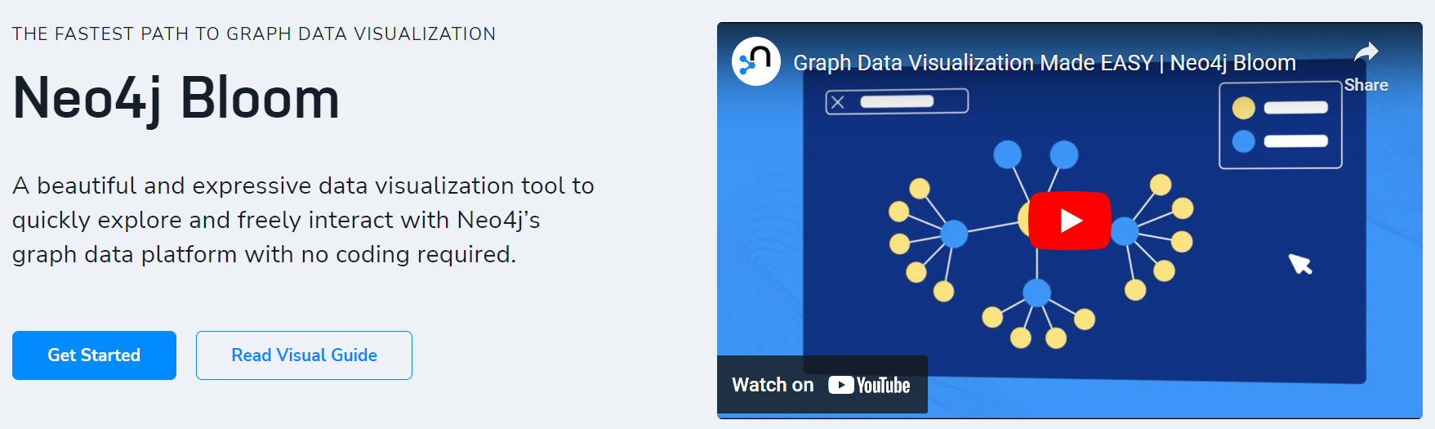
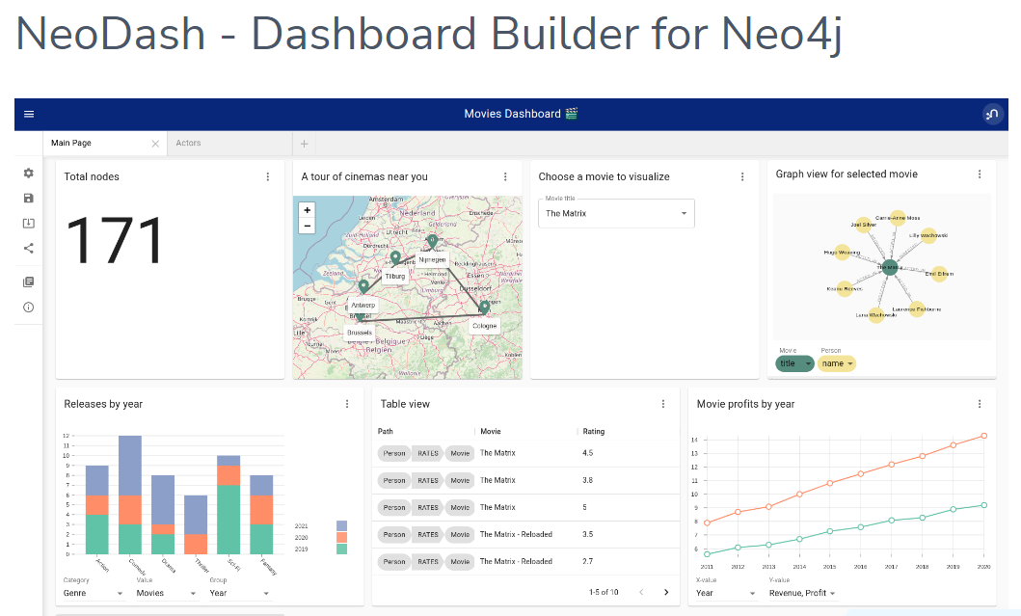
Visualization
Neo4j Bloom
NeoDash
neo4j.com/product/bloom/
neo4j.com/labs/neodash/

Slide 55
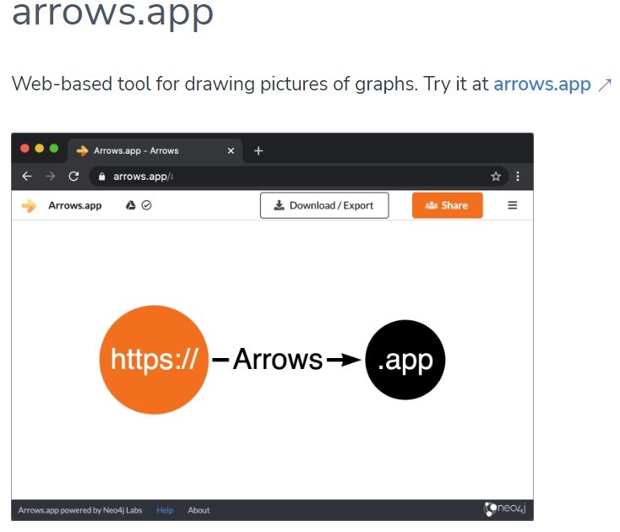


Dev Tools
Neo4j Arrows
Neo4j Desktop
Neo4j Browser
Neo4j Data Importer
neo4j.com/labs/
neo4j.com/developer/neo4j-desktop/ neo4j.com/docs/browser-manual/current/

Slide 56
How do I continue my journey with Neo4j?
Notes:
How do I get started with Graph Apps?

Slide 57


Continue your journey
Free online training and certification:
graphacademy.neo4j.com/
dev.neo4j.com/datasets
How to, best practices, hands on and community stories:
dev.neo4j.com/videos
Come say hello :)
dev.neo4j.com/chat
dev.neo4j.com/forum

Slide 58
Thank you!

